Slide 1
Code of Practice
9th edition
October 2021 update
- For clinic staff

Slide 2
Changes to guidance
Legislative changes
Legislative changes since the Code of Practice was last updated in 2019 – we have already communicated these changes to the sector through Chair’s Letters, and the requirements are already in force.
Least substantive changes
Smaller additions to our Code of Practice, mostly incorporation of guidance previously communicated through our Clinic Focus newsletter.
Most substantive changes
More substantive changes to guidance build upon and clarify areas of existing HFEA guidance.
In this presentation, all changes highlighted in yellow are to be removed, changes set out in red are additions.

Slide 3
Legislative changes

Slide 4
Legislative changes
Area of guidance (already in force and communicated to clinics) | Guidance note
New distinct GB/NI Licence conditions | 11, 15, 17, 19, 25, 26
Updated guidance on the Single European Code for NI | 15
Marking of medical devices | 26
Import and export of gametes and embryos | 16
Data protection – UK GDPR | 30
Extension of storage: COVID-19 storage Regulations | 17

Slide 5
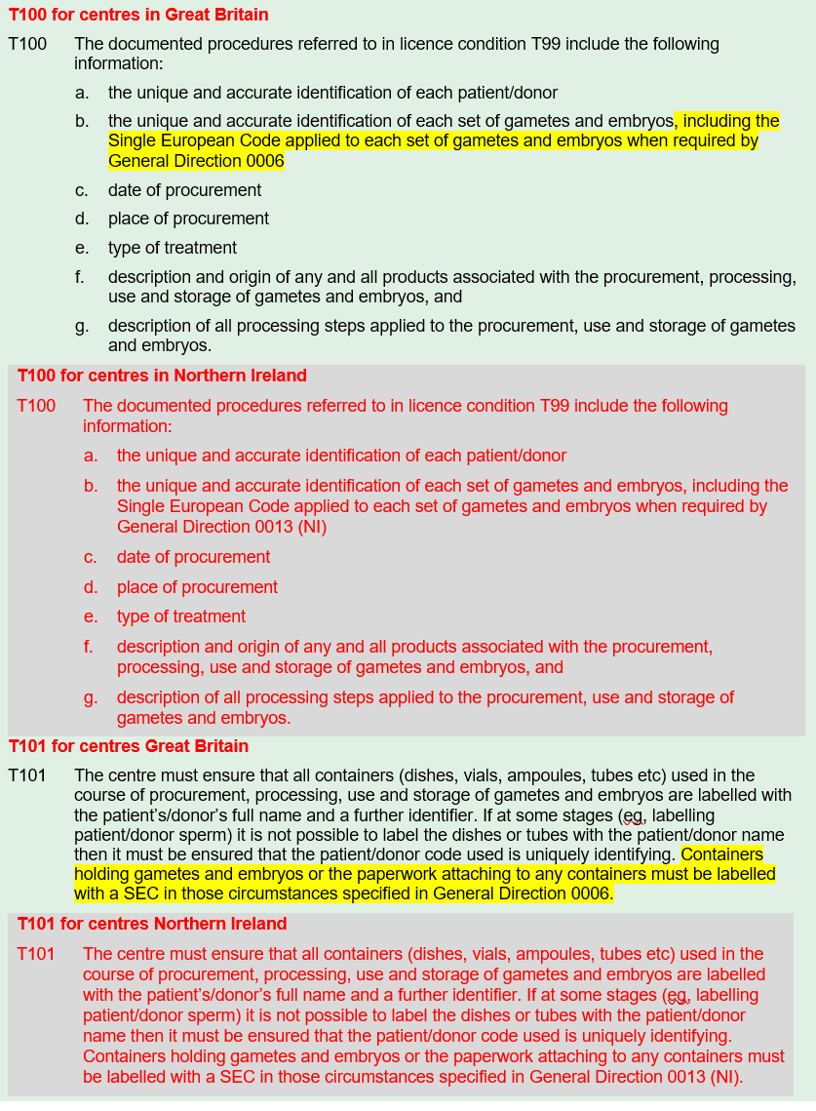
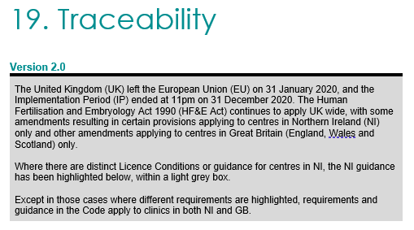
New distinct GB/NI Licence conditions
Guidance
Guidance note 11 (T53)
Guidance note 15 (T51)
Guidance note 17 (T51)
Guidance note 19 (T100, T101)
Guidance note 25 (T20, T21)
Guidance note 26 (T30, T31)

Slide 6
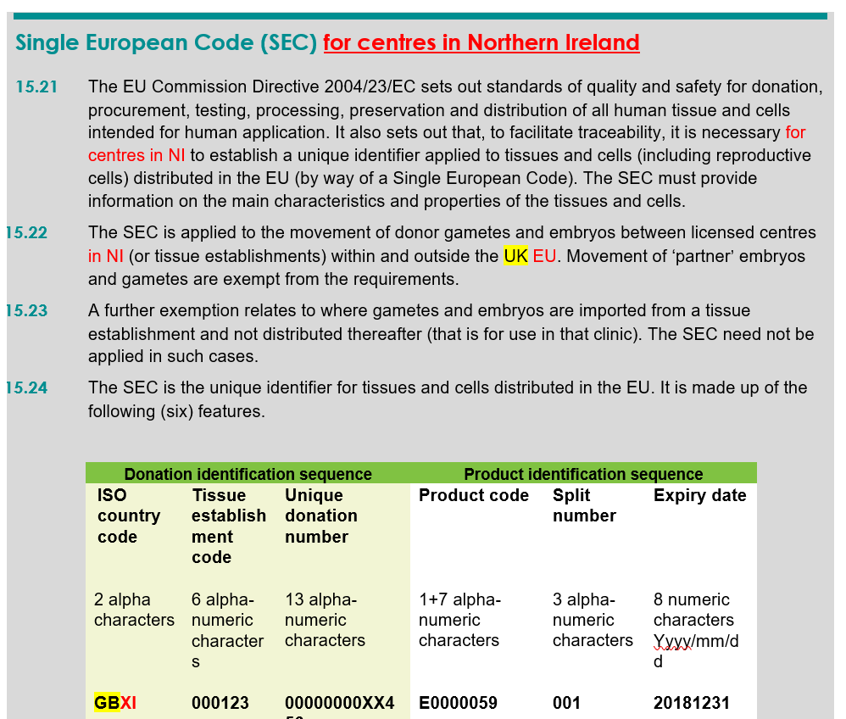
Guidance
Guidance note 15
Updated guidance on the SEC for NI
15.21, 15.22, 15.24, 15.26, 15.30, 15.31

Slide 7
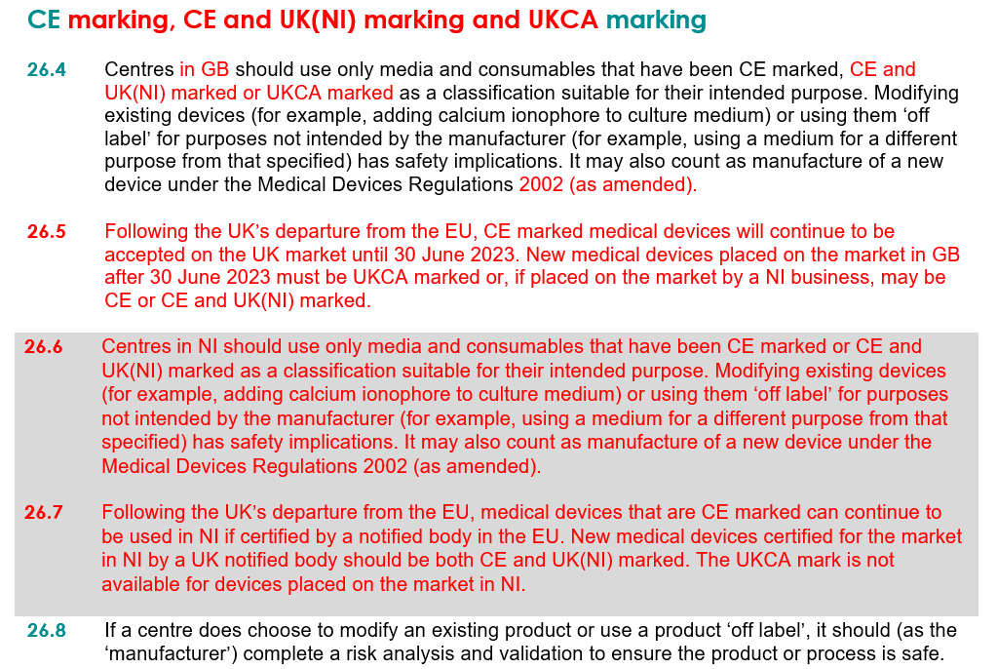
Guidance
Guidance note 26
Marking of medical devices
26.4 - 26.7

Slide 8
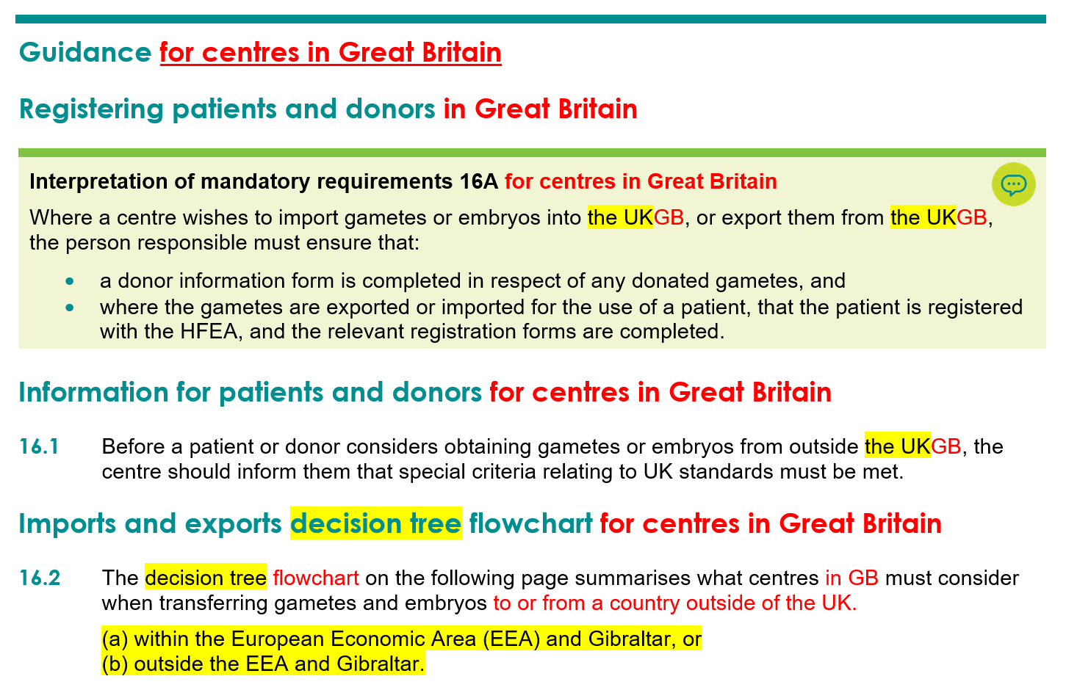
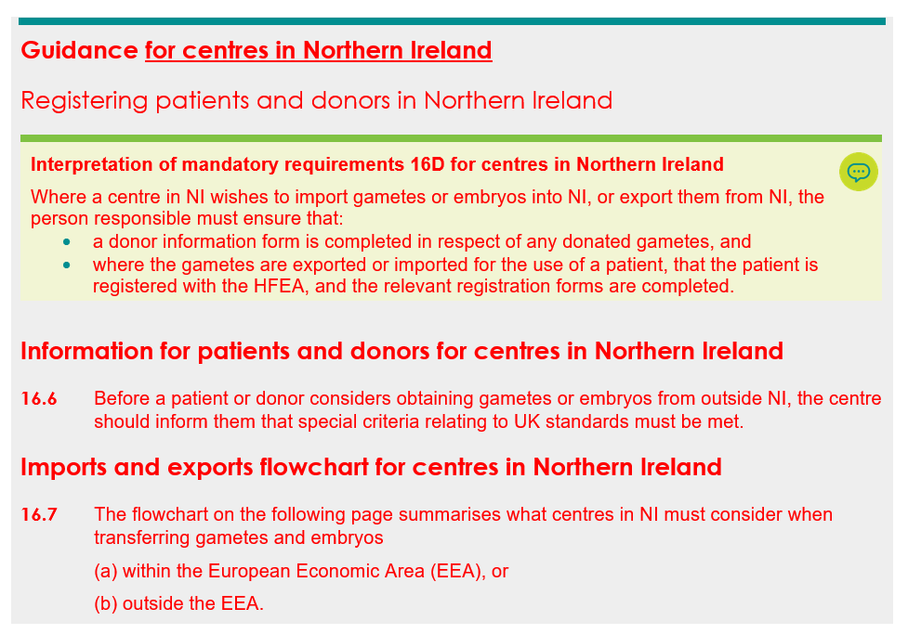
Guidance
Guidance note 16
Import and export of gametes and embryos
Mandatory requirements, 16.1-16.12

Slide 9


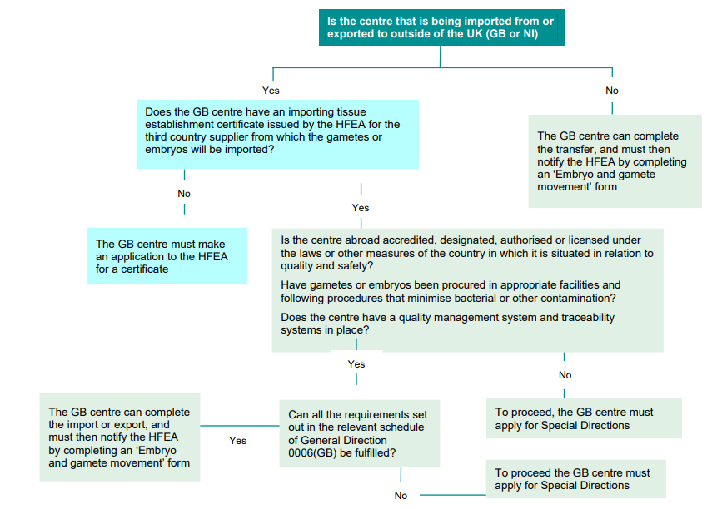
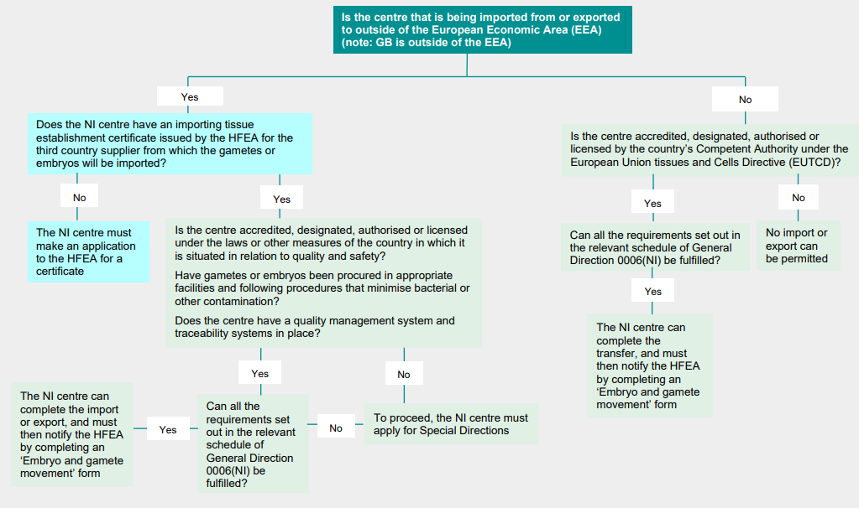
Guidance
Guidance note 16
Import and export of gametes and embryos
GB NI

Slide 10
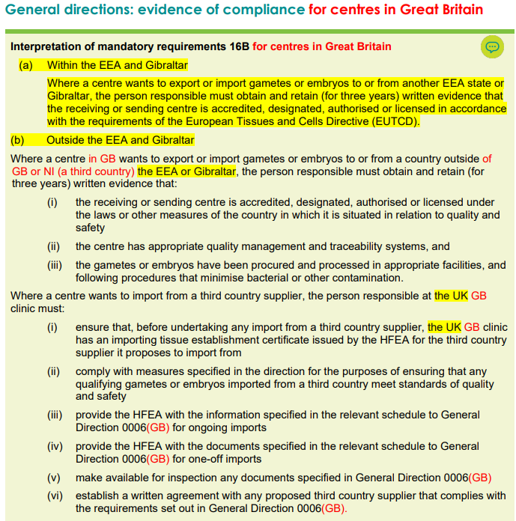
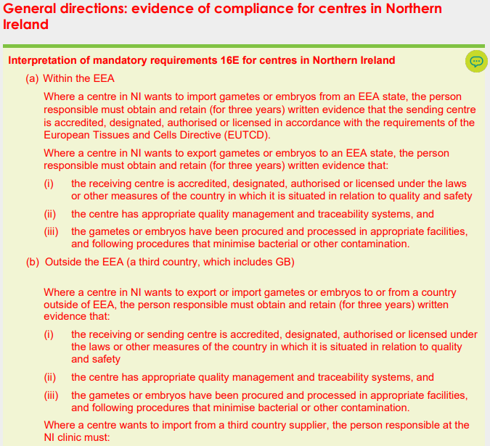
Guidance
Guidance note 16
Import and export of gametes and embryos

Slide 11
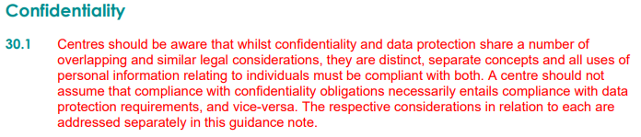
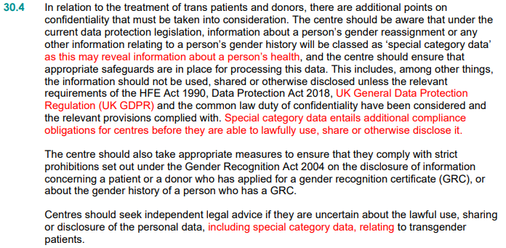
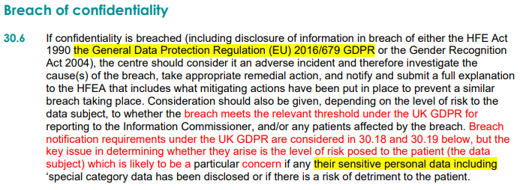
Guidance
Guidance note 30
Data protection – UK GDPR
30.1, 30.2, 30.4, 30.6-30.9, 30.11-30.23

Slide 12
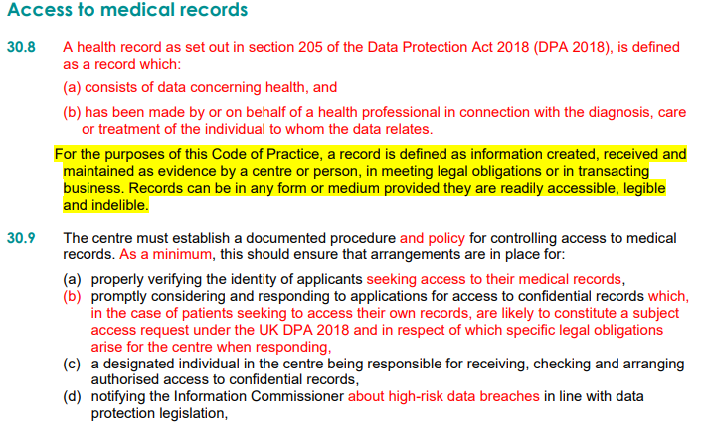
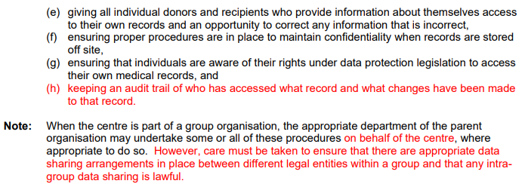
Guidance
Guidance note 30
Data protection – UK GDPR
30.1, 30.2, 30.4, 30.6-30.9, 30.11-30.23

Slide 13
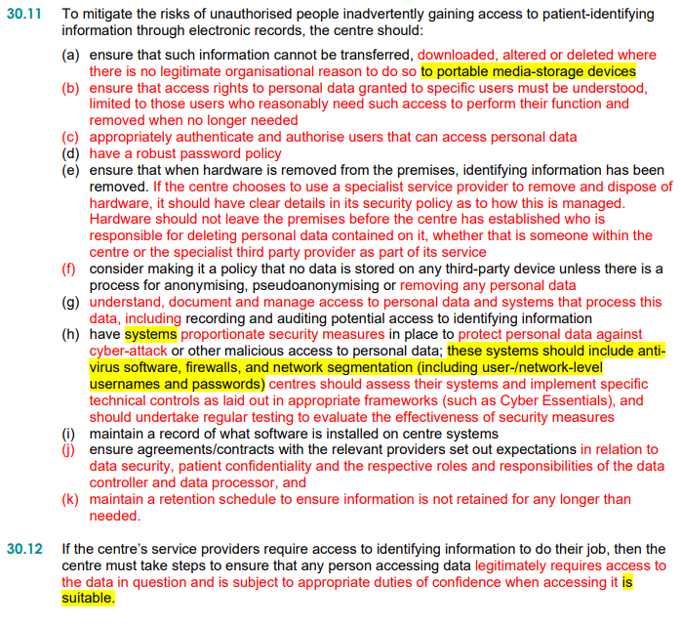
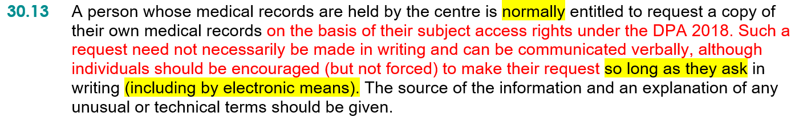
Guidance
Guidance note 30
Data protection – UK GDPR
30.1, 30.2, 30.4, 30.6-30.9, 30.11-30.23

Slide 14
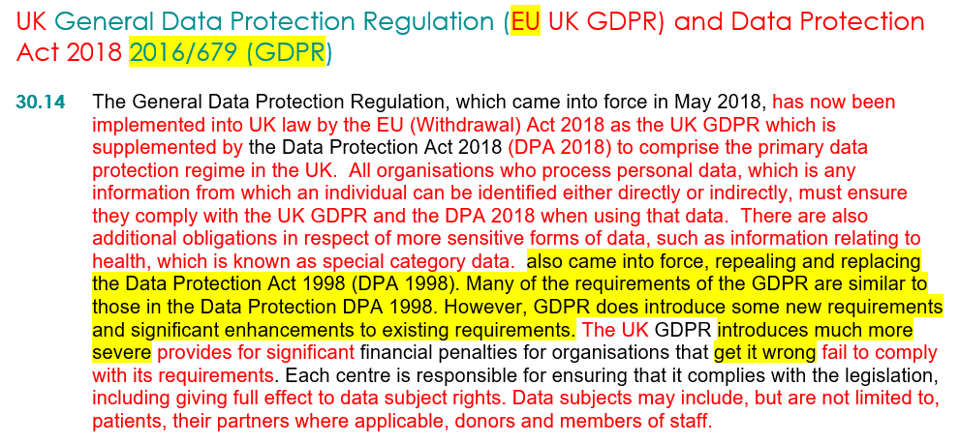
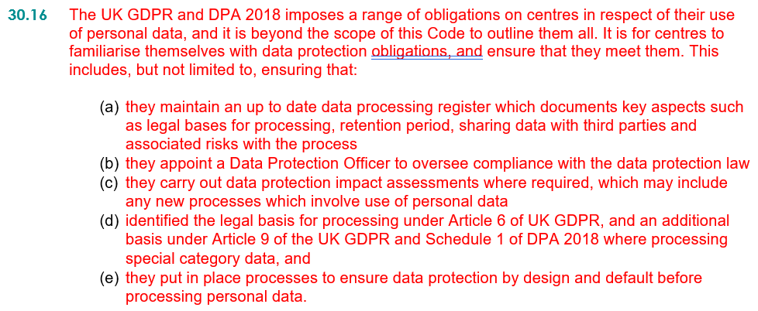
Guidance
Guidance note 30
Data protection – UK GDPR
30.1, 30.2, 30.4, 30.6-30.9, 30.11-30.23

Slide 15
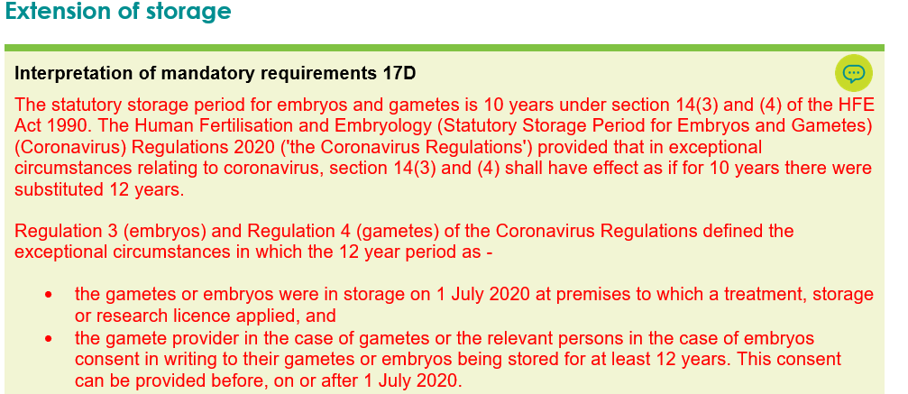
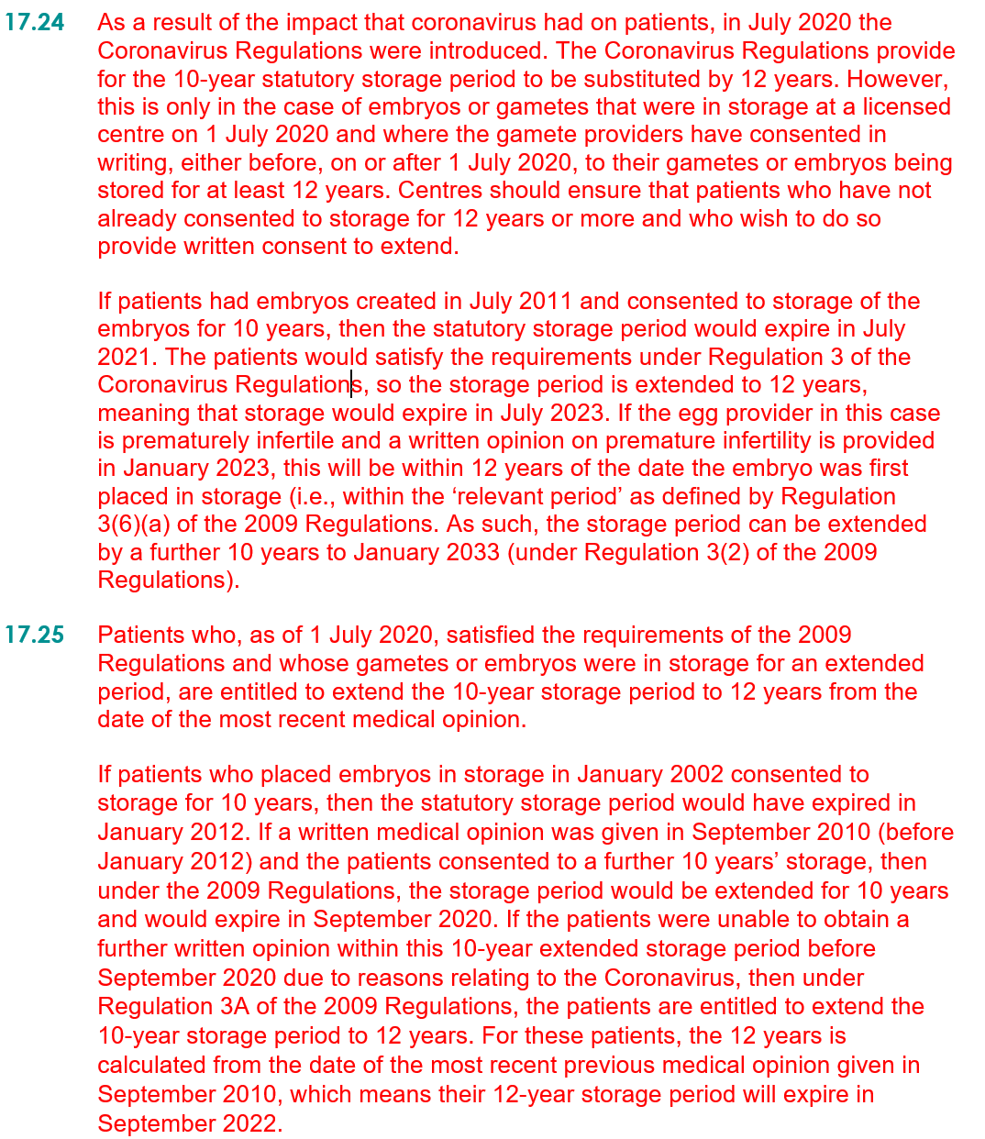
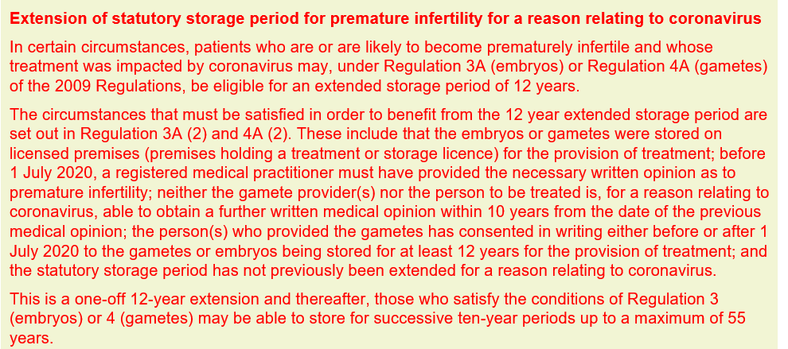
COVID-19 storage Regulations
Guidance
Guidance note 17
Mandatory requirements, Interpretation of mandatory requirements 17D, 17.20, 17.22, 17.24-17.26

Slide 16
Least substantive changes

Slide 17
Least substantive changes
Area of guidance | Guidance note
Reference to CMA guidance on consumer law for the fertility sector | 4
Storing gametes and embryos that have been imported into the UK. | 17
Storage when legal proceedings are threatened or commenced. | 17
Exporting gametes or embryos for patients seeking commercial surrogacy abroad. | 14
Disclosure of medical records of a deceased patient | 30
Terminology of PGS and PGD to PGT-A and PGT-M/PGT-SR | 9, 10, 33

Slide 18
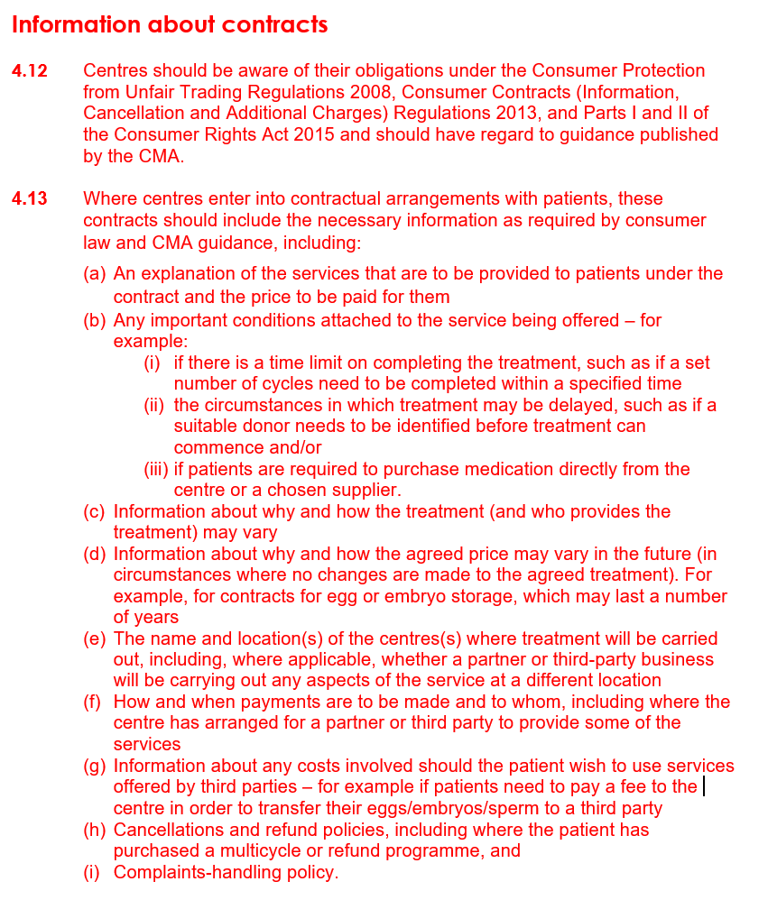
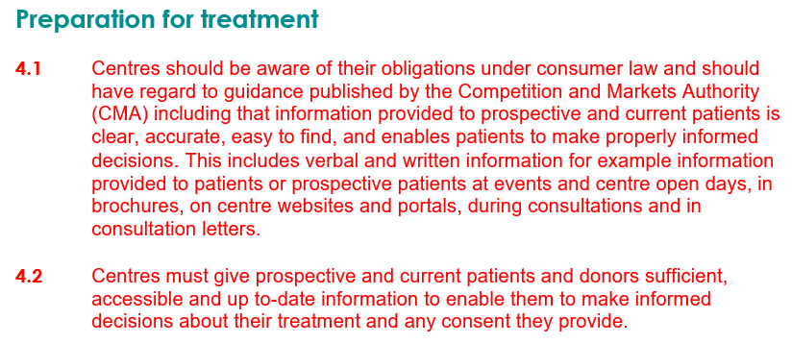
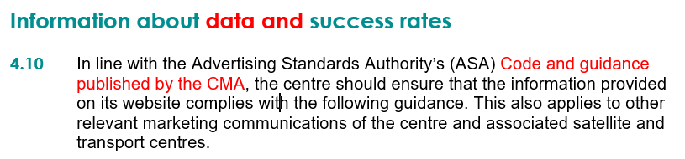
Reference to CMA guidance on consumer law for the fertility sector
Guidance
Guidance note 4
4.1-4.2, 4.8, 4.10-4.13

Slide 19
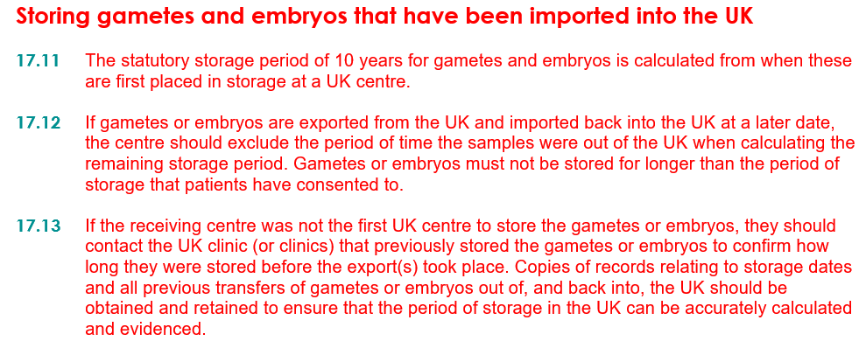
Storing gametes and embryos that have been imported into the UK
Guidance
Guidance note 17
17.11-17.13
Notes:
July 2019: clinic focus article about storage periods for imported gametes.
February 2021: clinic focus article providing clarification on how to calculate storage periods for gametes and embryos that may have been exported then re-imported back into the UK.

Slide 20
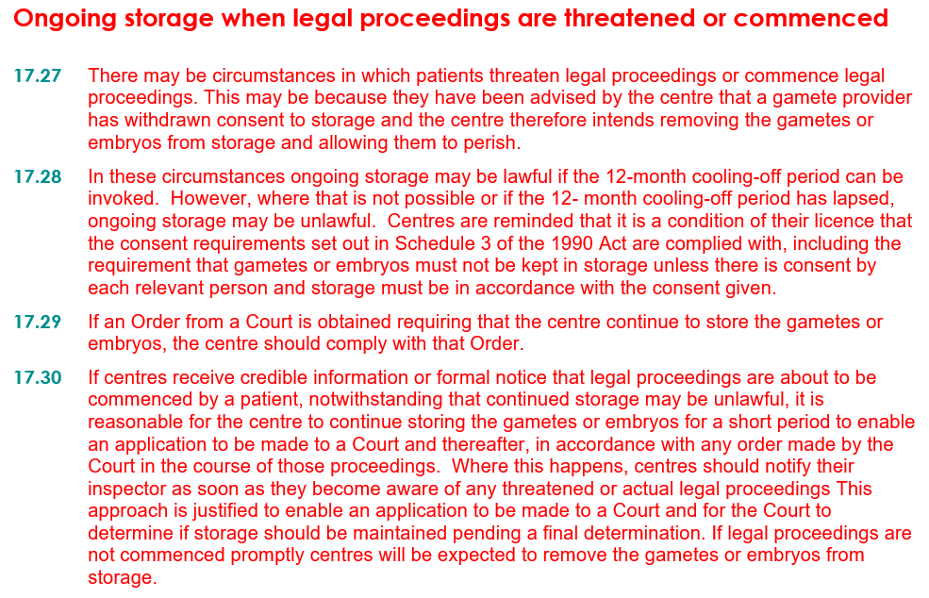
Storage when legal proceedings are threatened or commenced
Guidance
Guidance note 17
17.27-17.30
Notes:
2003: Chair’s Letter CH(03)03 about withdrawal of consent and ongoing storage when legal proceedings are threatened or commenced.

Slide 21
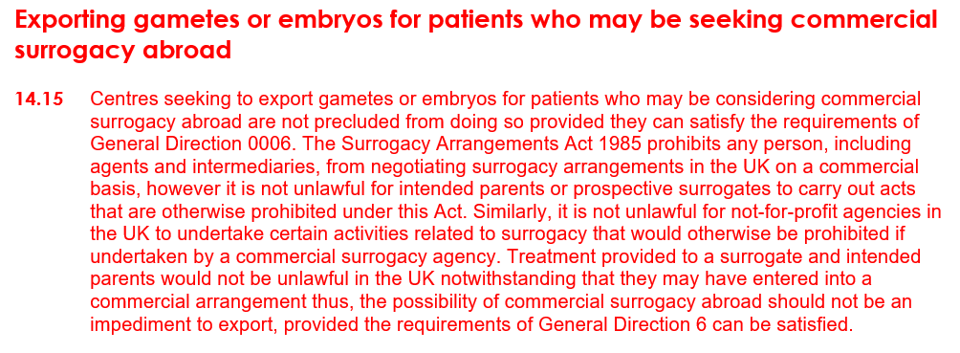
Exporting gametes or embryos for patients seeking commercial surrogacy abroad
Guidance
Guidance note 14
14.15
Notes:
December 2020: clinic focus article to provide clarification about whether, or in what circumstances, it is possible to export gametes or embryos for surrogacy, particularly when patients intend entering into commercial surrogacy arrangements abroad

Slide 22
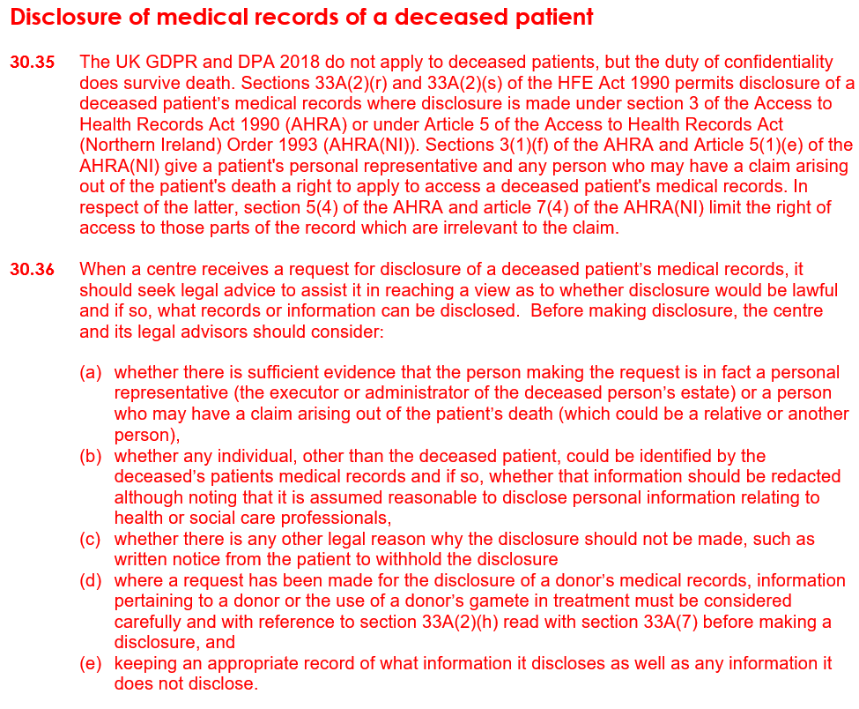
Disclosure of medical records of a deceased patient
Guidance
Guidance note 30
30.35-30.36
Notes:
August 2020: clinic focus article to provide clarification on key points to consider if centres receive a disclosure request for the medical records of a deceased patient at their clinic.

Slide 23

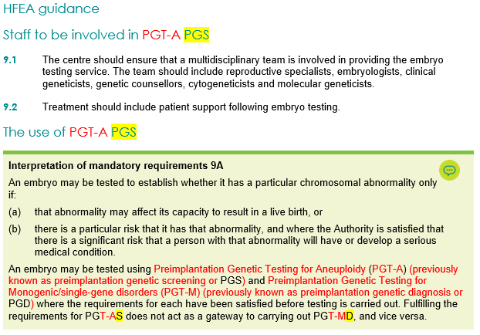
Terminology of PGS and PGD to PGT-A and PGT-M/PGT-SR
Guidance
Guidance note 9
Guidance note 10
Guidance note 33

Slide 24
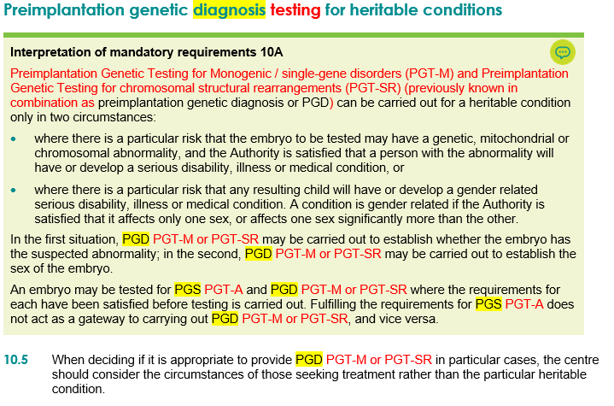
Terminology of PGS and PGD to PGT-A and PGT-M/PGT-SR
Guidance
Guidance note 9
Guidance note 10
Guidance note 33

Slide 25
Most substantive changes

Slide 26
Most substantive changes
To provide clarification and build upon existing guidance
Area of guidance | Guidance note
Definition of a family for the existing 10-family limit policy | 11, 20
Introduction of electronic consenting platforms | 5
Legal parenthood when relationships break down and patients return for further treatment | 6
Witnessing – requiring three identifiers | 18
Medicines management – complying with the relevant regulations, best practice, and professional body guidance | 25

Slide 27
Definition of a family for the existing 10-family limit policy

Slide 28
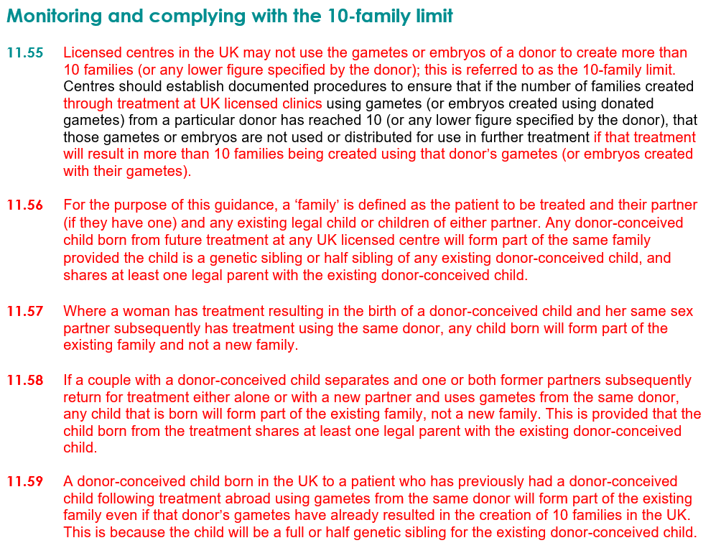
Guidance
Guidance note 11
Definition of a family
11.35, 11.55-11.60

Slide 29
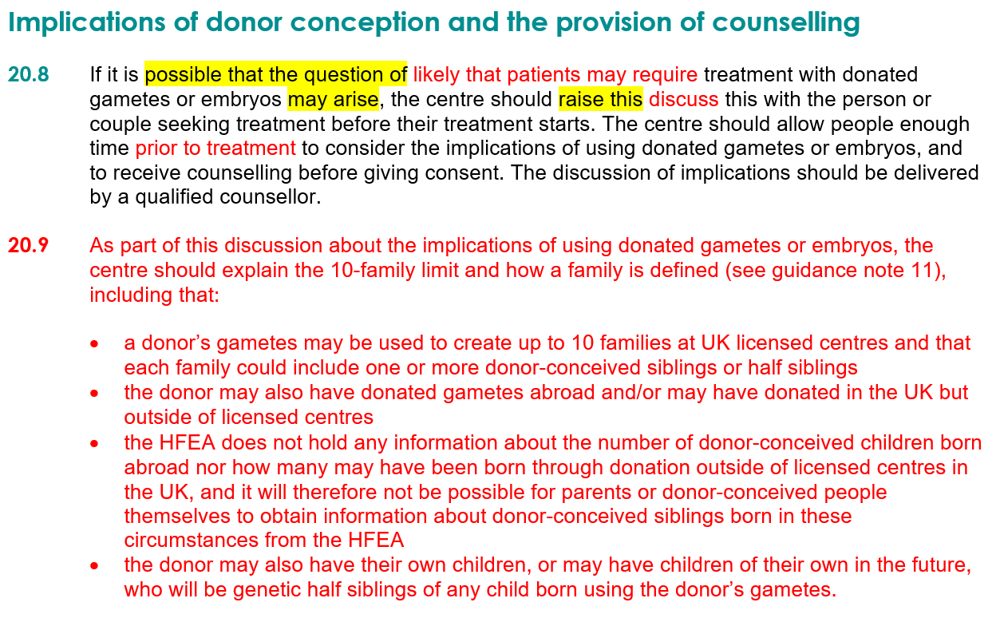
Guidance
Guidance note 20
Definition of a family
20.8-20.10

Slide 30
Electronic methods of taking consent

Slide 31
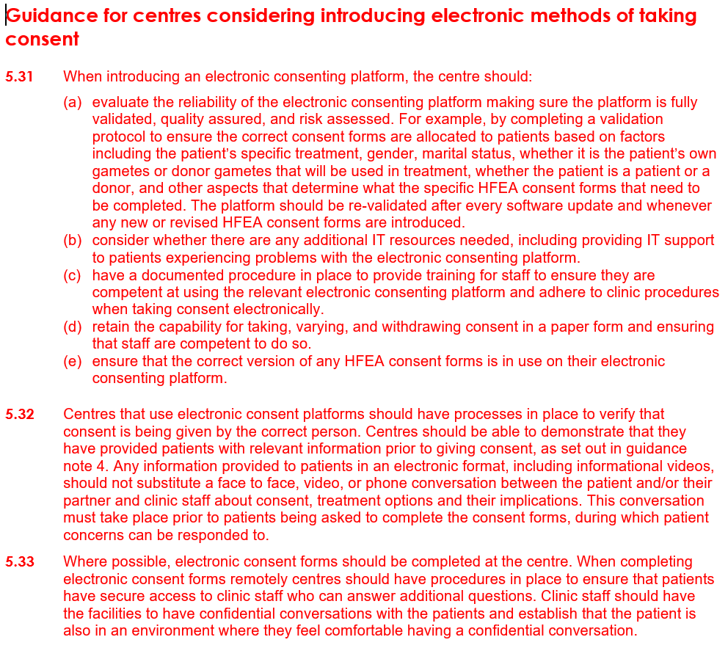
Guidance
Guidance note 5
Electronic consent
5.7, 5.11, 5.19, 5.31-5.38, 5.55

Slide 32
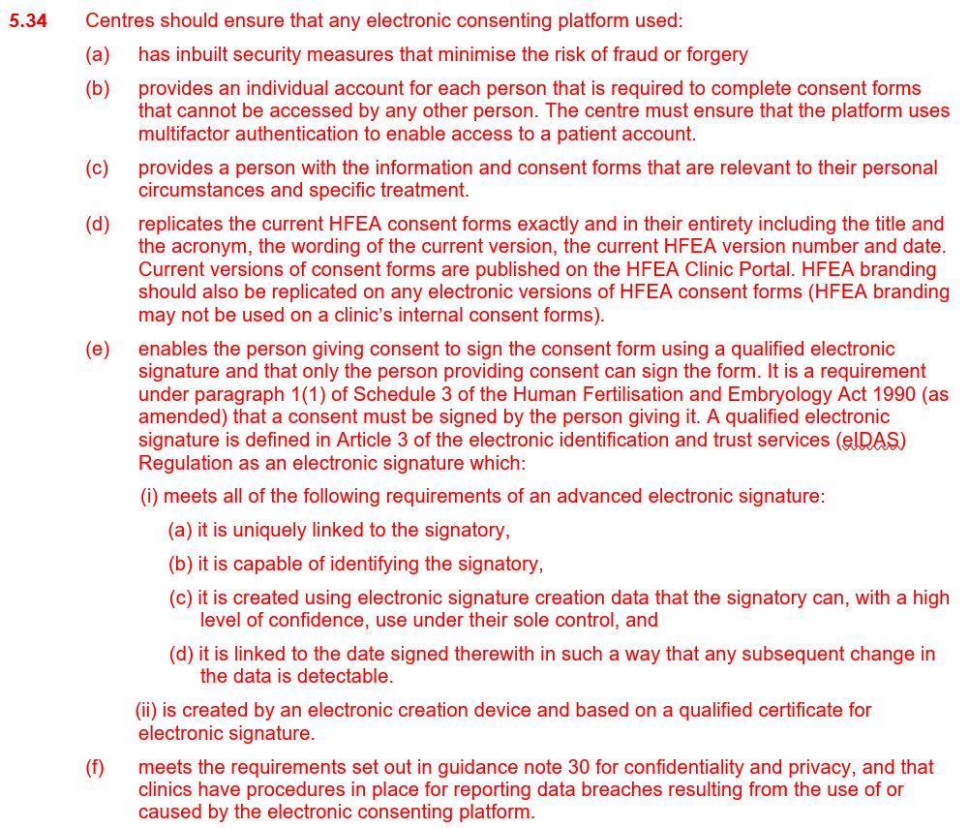
Guidance
Guidance note 5
Electronic consent
5.7, 5.11, 5.19, 5.31-5.38, 5.55

Slide 33
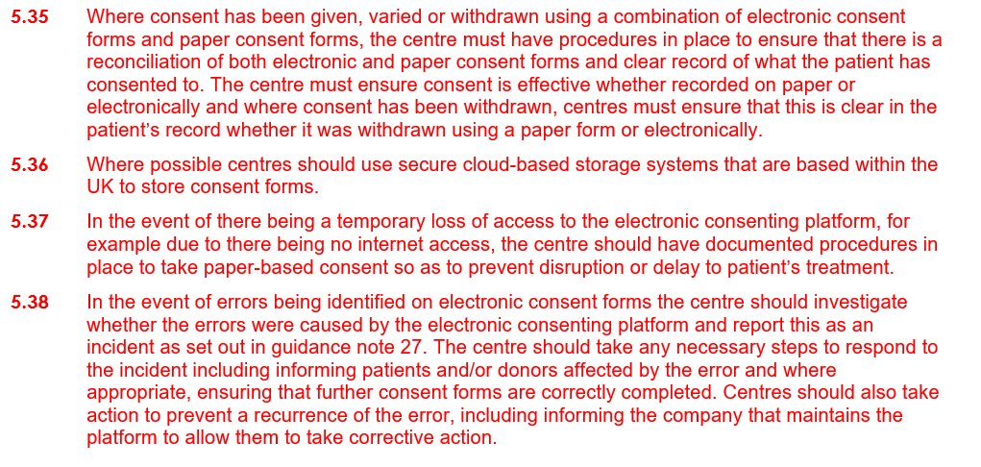
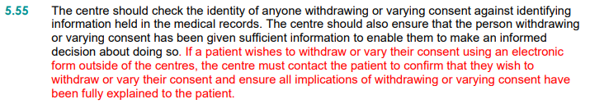
Guidance
Guidance note 5
Electronic consent
5.7, 5.11, 5.19, 5.31-5.38, 5.55

Slide 34
Legal parenthood when relationships break down and patients return for further treatment

Slide 35
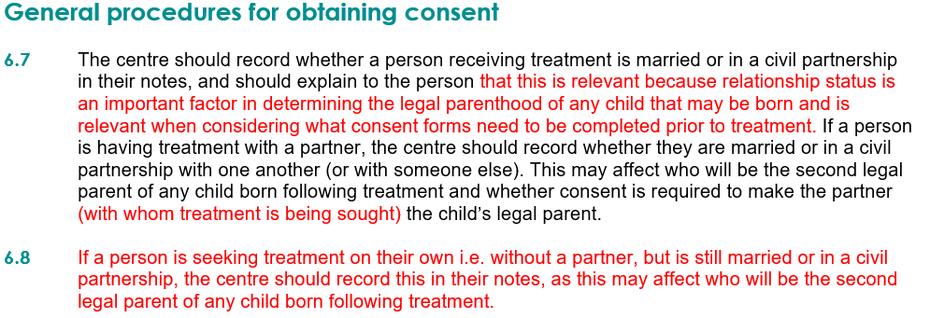
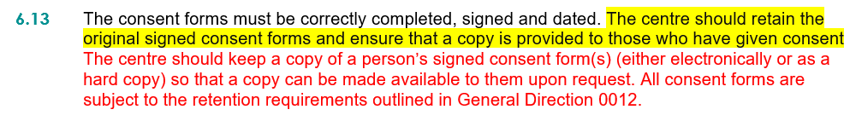
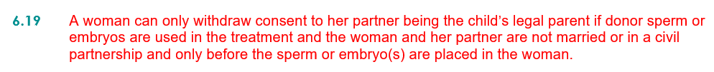
Guidance
Guidance note 6
Legal parenthood
Regulations, 6.4, 6.7, 6.8, 6.13, 6.19

Slide 36
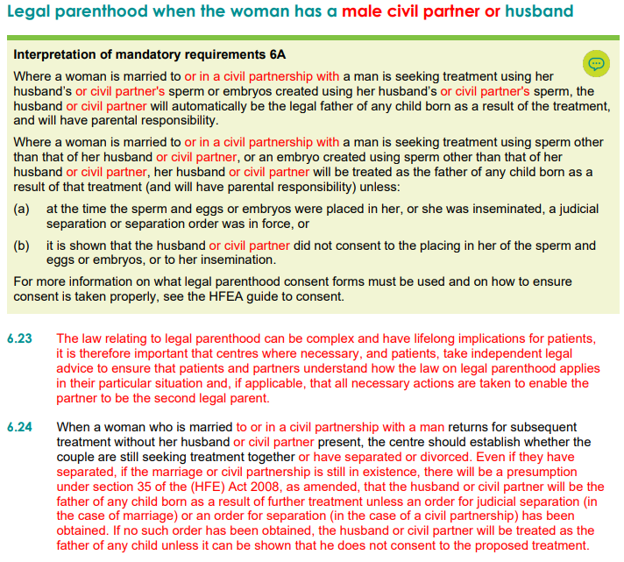
Guidance
Guidance note 6
Legal parenthood
6A, 6.23-6.24

Slide 37
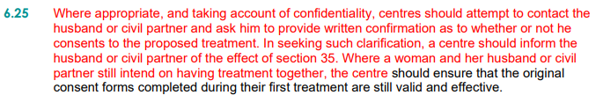
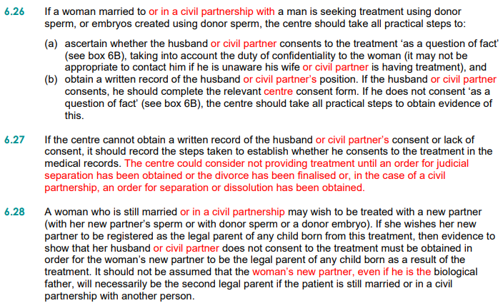

Guidance
Guidance note 6
Legal parenthood
6.25-6.29

Slide 38
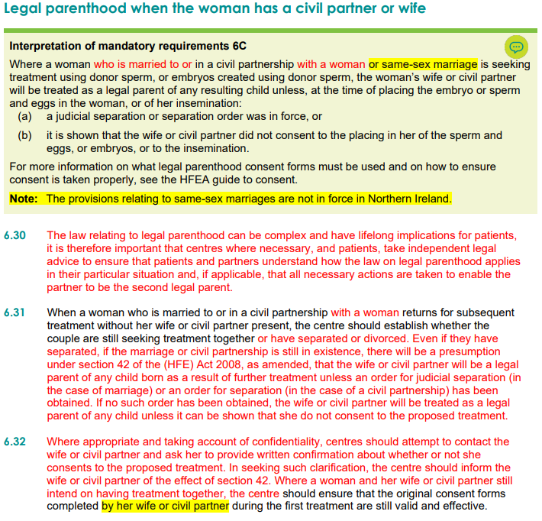
Guidance
Guidance note 6
Legal parenthood
6C, 6.30-6.33

Slide 39
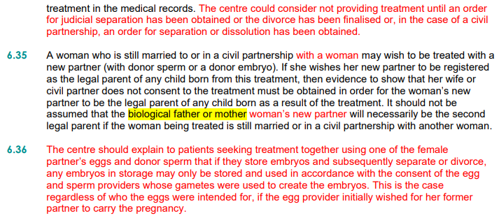
Guidance
Guidance note 6
Legal parenthood
6.34-6.36

Slide 40
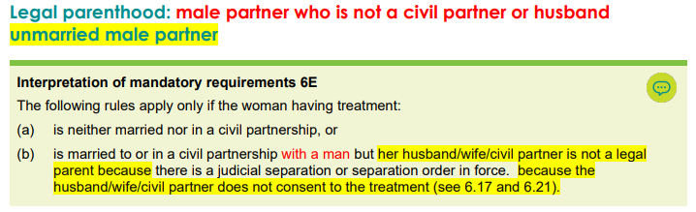
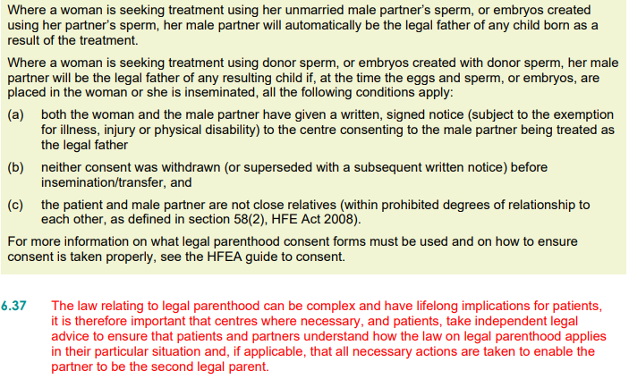
Guidance
Guidance note 6
Legal parenthood
6E, 6.37

Slide 41
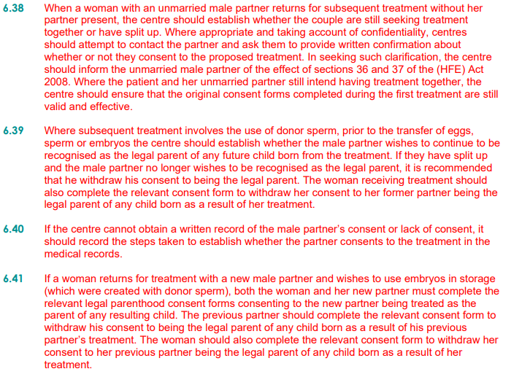

Guidance
Guidance note 6
Legal parenthood
6.38-6.42

Slide 42
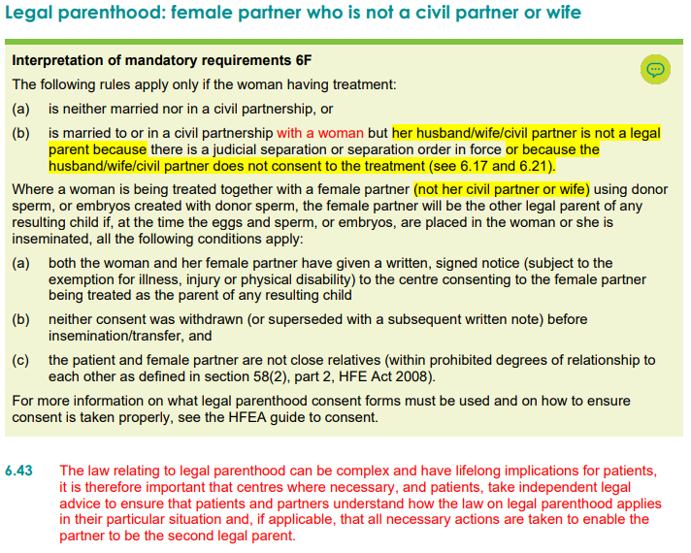
Guidance
Guidance note 6
Legal parenthood
6F, 6.43

Slide 43
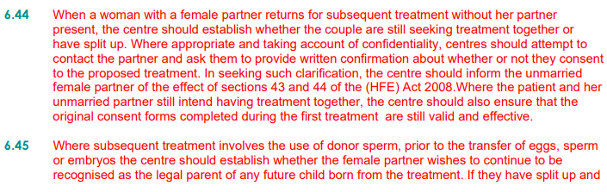

Guidance
Guidance note 6
Legal parenthood
6.44-6.48

Slide 44
Witnessing – requiring three identifiers

Slide 45


Guidance
Guidance note 18
Witnessing
18.4, 18.5, 18.21, 18.22, 18.41

Slide 46
Medicine’s management – complying with the relevant regulations, best practice, and professional guidelines

Slide 47

Guidance
Guidance note 25
Medicines management
25.21-25.28

Slide 48

Guidance
Guidance note 25
Medicines management
25.21-25.28

Slide 49
www.hfea.gov.uk

